Slide 1
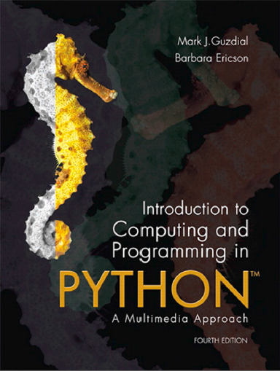
Introduction to Computing and Programming in Python™: A Multimedia Approach
Fourth Edition
Chapter 5
Picture Techniques with Selection
Copyright © 2016, 2013, 2010 Pearson Education, Inc. All Rights Reserved
Notes:
If this PowerPoint presentation contains mathematical equations, you may need to check that your computer has the following installed:
1) MathType Plugin
2) Math Player (free versions available)
3) NVDA Reader (free versions available)

Slide 2
Learning Objectives (1 of 2)
5.1 To understand how images are digitized by taking advantage of limits in human vision.
5.2 To identify different models for color, including R G B, the most common one for computers.
5.3 To manipulate color values in pictures, like increasing or decreasing red values.
5.4 To convert a color picture to grayscale, using more than one method.
5.5 To negate a picture.

Slide 3
Learning Objectives (2 of 2)
5.6 To use a matrix representation in finding pixels in a picture.
5.7 To use the objects pictures and pixels.
5.8 To use iteration (with a for loop) for changing the color values of pixels in a picture.
5.9 To nest blocks of code within one another.
5.10 To choose between having a function return a value and just providing a side effect.
5.11 To determine the scope of a variable name.

Slide 4
Pixels are in a Matrix
Matrices have two dimensions: A height and a width
We can reference any element in the matrix with (x,y) or (horizontal, vertical)
We refer to those coordinates as index numbers or indices
We sometimes want to know where a pixel is, and getPixels doesn’t let us know that.

Slide 5
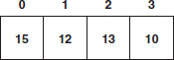
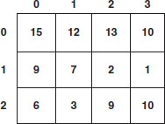
Arrays versus Matrices
Figure 4.1 An example array.
Figure 4.2 An example matrix.

Slide 6
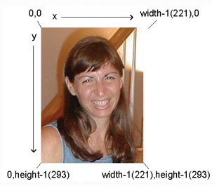
Pixels in a Matrix
“Barbara.jpg” has
height 293 (bottommost index is 292) and
width 221 (rightmost index is 220)

Slide 7
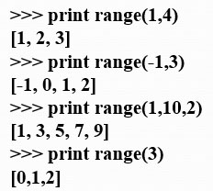
Indices from the Function Range
Range returns a sequence between its first two inputs, possibly using a third input as the increment
Notice:
End value is never included.
range(0,10) ends at 9.
If you leave out a start value, it’s assumed to be zero.

Slide 8
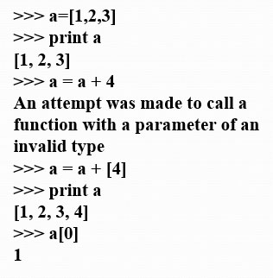
Side Note: That Thing in [] is a Sequence
We can assign names to sequences, print them, add items to sequences, and access individual pieces of them.
We can also use for loops to process each element of a sequence.

Slide 9
We Can Use Range to Generate Index Numbers
We’ll do this by working the range from 0 to the height-1, and 0 to the width-1.
Using the range function will make it easy to start from 0 and stop before the end value.
But we’ll need more than one loop.
Each for loop can only change one variable, and we need two for indexing a matrix

Slide 10
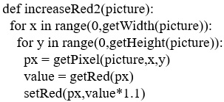
Working the Pixels by Number
To use range, we’ll have to use nested loops
One to walk the width, the other to walk the height
Be sure to watch your blocks (i.e., indentation) carefully!

Slide 11
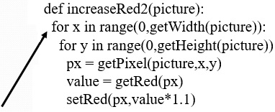
What’s Going on Here?
The first time through the first loop, x is the name for 0.
We’ll be processing the first column of pixels in the picture.

Slide 12
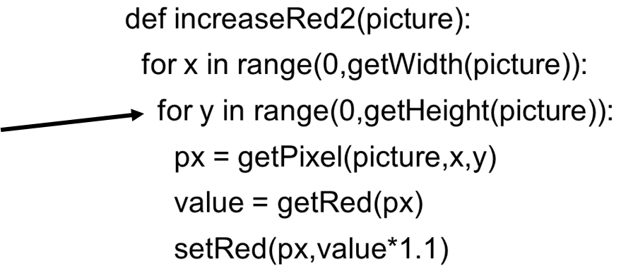
Now, the Inner Loop
Next, we set y to 0. We’re now going to process each of the pixels in the first column.

Slide 13
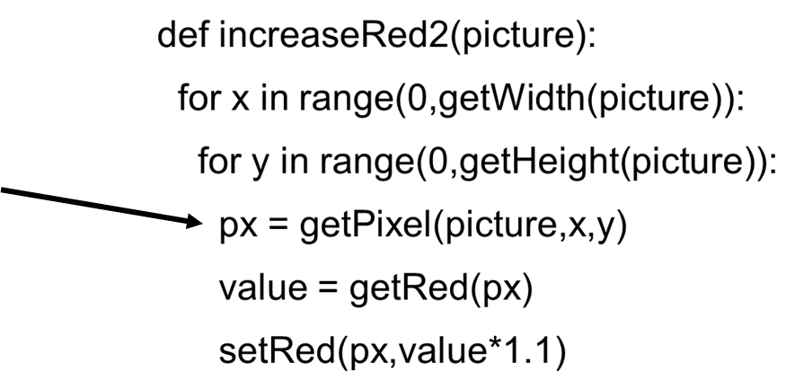
Process a Pixel
With x = 0 and y = 0, we get the leftmost pixel and increase its red by 10%

Slide 14
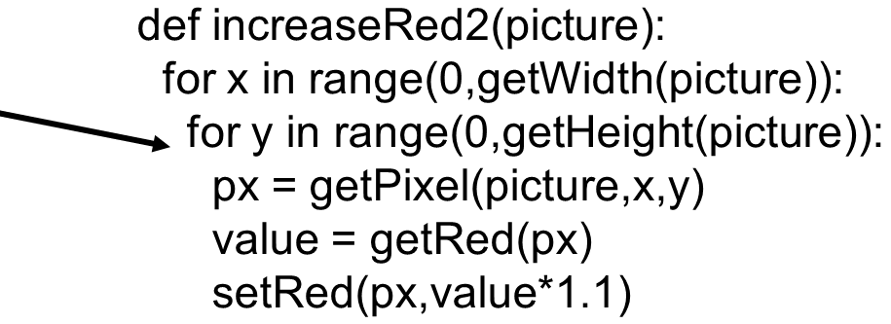
Next Pixel
Next we set y to 1 (next value in the sequence

Slide 15
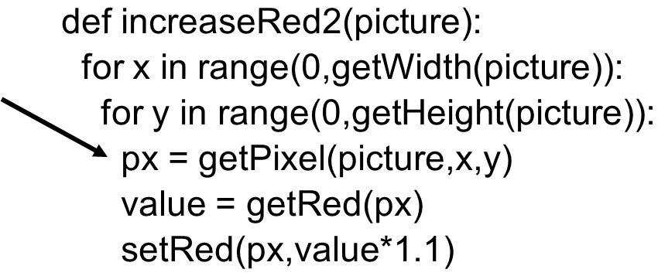
Process Pixel (0,1)
x is still 0, and now y is 1, so increase the red for pixel (0,1)
We continue along this way, with y taking on every value from 0 to the height of the picture (minus 1).

Slide 16
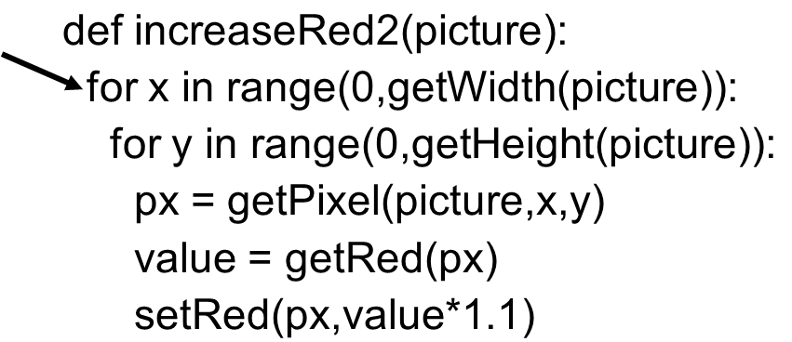
Finally, Next Column
Now that we’re done with the loop for y, we get back to the FOR loop for x. x takes on the value 1, and we go back to the y loop to process all the pixels in the column x=1.

Slide 17
What Can You Do if You Know Where the Pixels are? One Answer: Mirroring
Imagine a mirror horizontally across the picture, or vertically
What would we see?
How do generate that digitally?
We simply copy the colors of pixels from one place to another

Slide 18
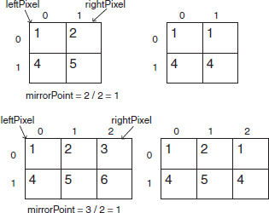
Work it out with Matrices
mirrorPoint is halfway across:
If left pixel is at (x,y), right pixel is at (width-x-1,y)

Slide 19
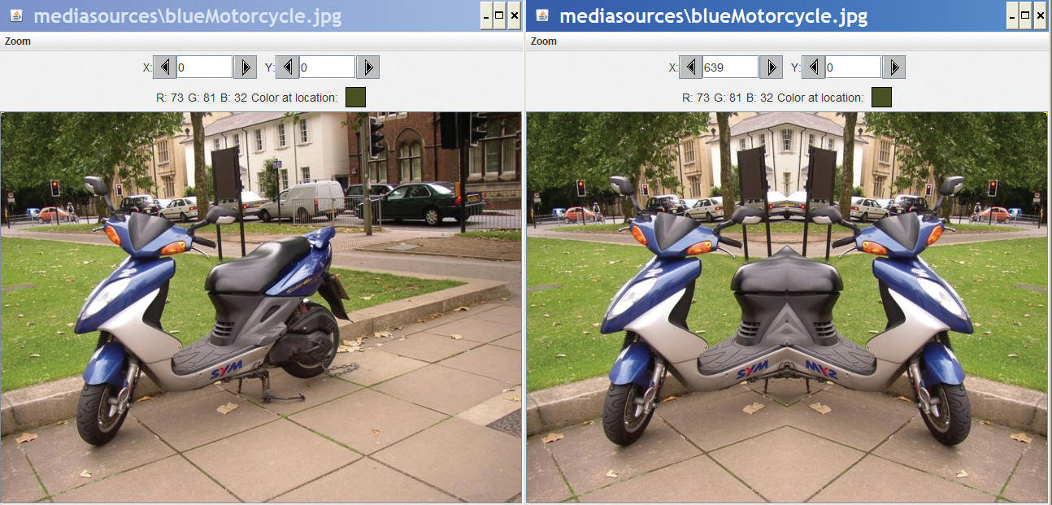
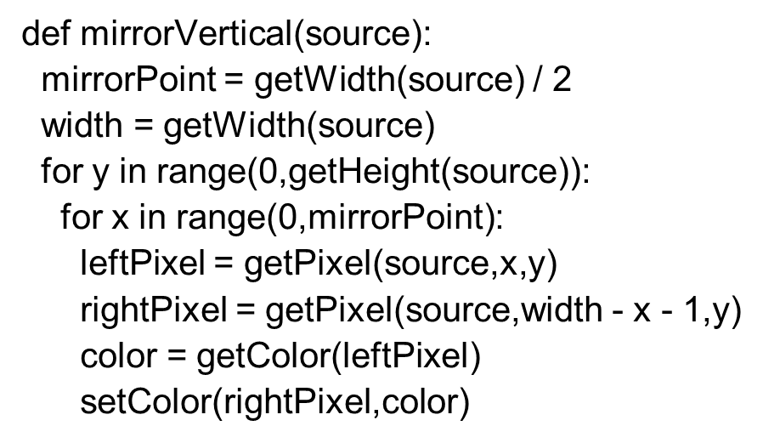
Recipe for Mirroring

Slide 20
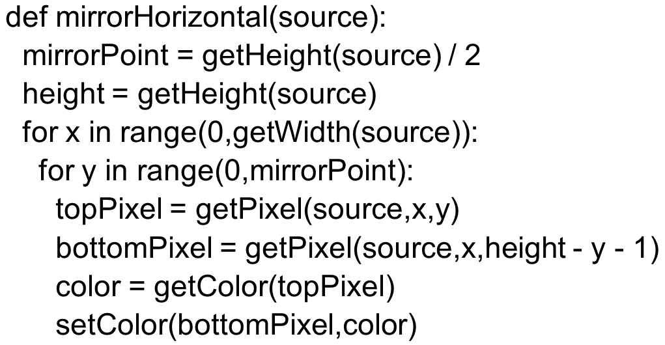
Can We Do it with a Horizontal Mirror?

Slide 21
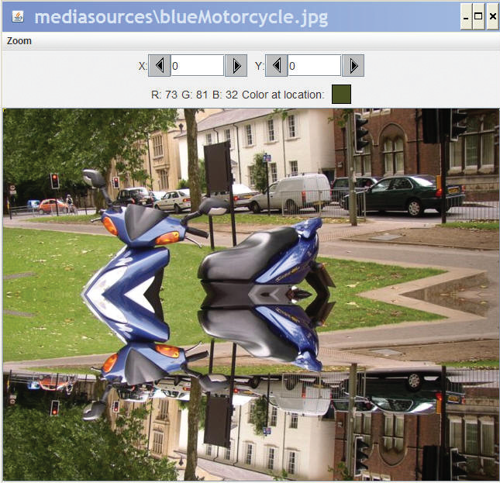
Of Course!

Slide 22
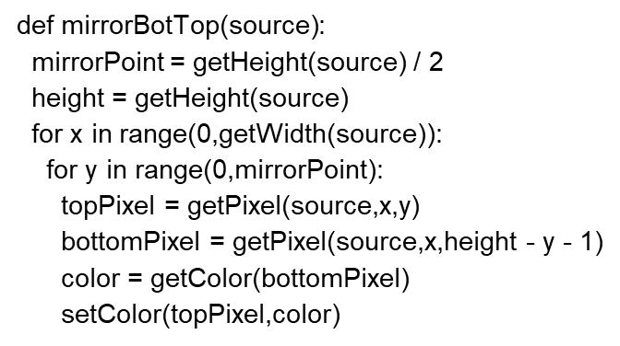
What If We Wanted to Copy Bottom to Top?
Very simple: Swap the order of pixels in the bottom lines

Slide 23
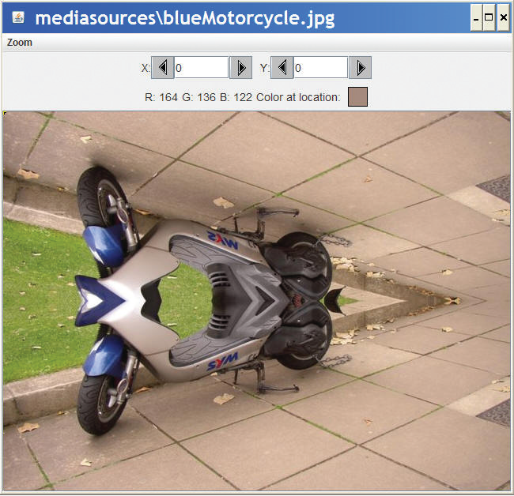
Mirroring Bottom to Top

Slide 24
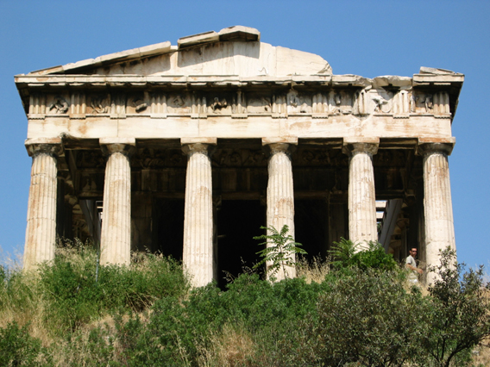
Doing Something Useful with Mirroring
Mirroring can be used to create interesting effects, but it can also be used to create realistic effects.
Consider this image from a trip to Athens, Greece.
Can we “repair” the temple by mirroring the complete part onto the broken part?

Slide 25
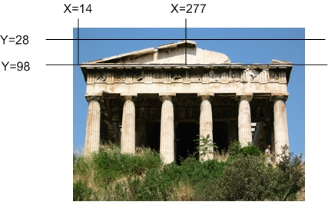
Figuring out Where to Mirror
Use MediaTools to find the mirror point and the range that we want to copy

Slide 26
Writing Functions for Specific Files…Generally
The function to mirror the temple needs to work for one and only one file.
But we still don’t want to write out the whole path.
allows us to pick a directory where
our media will be stored.
will generate the entire path
filename in the media directory
This Only Works When We’re Accessing Files in the Media Directory and Where We Have Set the Path First!

Slide 27
Some Utility Functions
If you know the name of the file, searching for it with
feels tedious
You can set and get a media folder (path) for remembering a place where your media will be coming from (or going to)
lets you pick a file in your media
folder
lets you generate a
complete filename out of only the last part

Slide 28
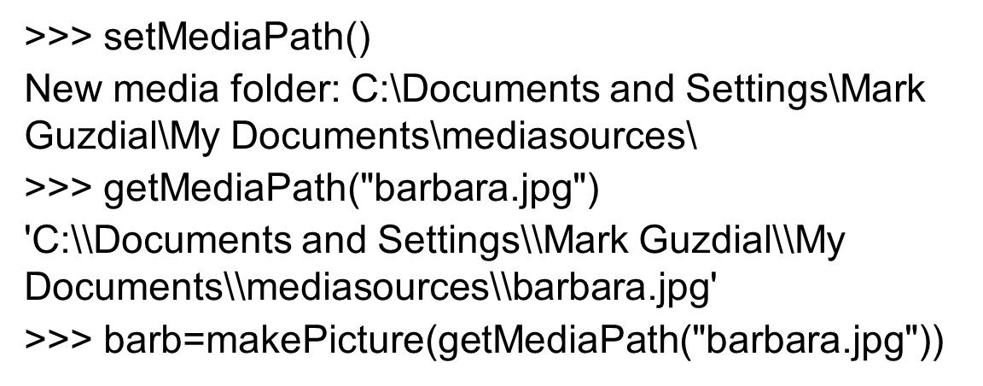
Example

Slide 29
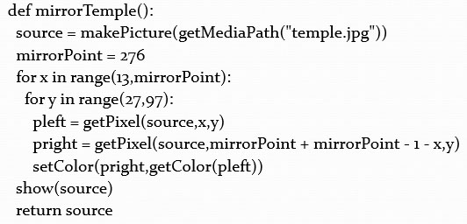
Program to Mirror the Temple

Slide 30
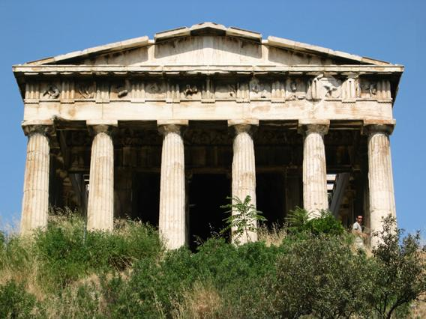
Did it Really Work?
It clearly did the mirroring, but that doesn’t create a 100% realistic image.
Check out the shadows: Which direction is the sun coming from?

Slide 31
Understanding the Temple Fix
What is the very first transfer of pixels from and to? Which (x,y) pixel from? Which (x,y) pixel to?
What is second?
How many pixels get copied?

Slide 32
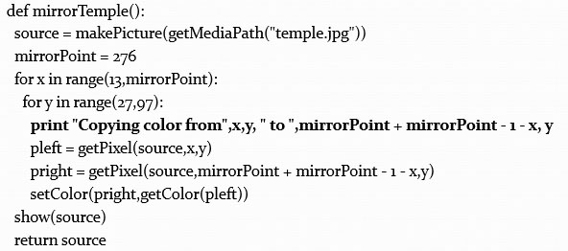
Adding Print Statements to See What’s Happening

Slide 33
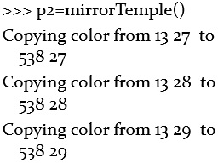
First Pixels are Either Side of the Mirrorpoint, Then Moving Down

Slide 34
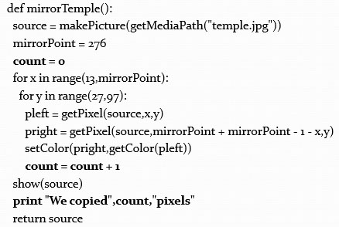
Counting Pixels (1 of 2)

Slide 35
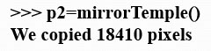
Counting Pixels (2 of 2)
Where did that come from?
How many rows? Y goes from 27 to 97
= 70 rows of pixels
How many columns? X goes from 13 to 276
= 263 columns of pixels

Slide 36
Moving Pixels Across Pictures
We’ve seen using index variables to track the pixel position we’re working with in a picture.
We can copy between pictures, if we keep track of:
The source index variables
Where we’re getting the pixels from
The target index variables
Where we’re putting the pixels at
(Not really copying the pixels: Replicating their color.)

Slide 37
What Can You Do Then?
What can you do when copying from one picture to another?
Collages: Copy several pictures onto one
Cropping: You don’t have to take the whole picture
Scaling: Make a picture smaller, or larger when copying it

Slide 38
Blank Files in Mediasources
gives you a J P E G canvas
which prints out as 7×9.5 inches
Letter-sized page with 1 inch margins
gives a J P E G canvas at a
common size: 640 pixels across by 480 pixels high

Slide 39
Copying Pixels
In general, what we want to do is to keep track of a sourceX and sourceY, and a targetX and targetY.
We increment (add to them) in pairs
sourceX and targetX get incremented together
sourceY and targetY get incremented together
The tricky parts are:
Setting values inside the body of loops
Incrementing at the bottom of loops

Slide 40
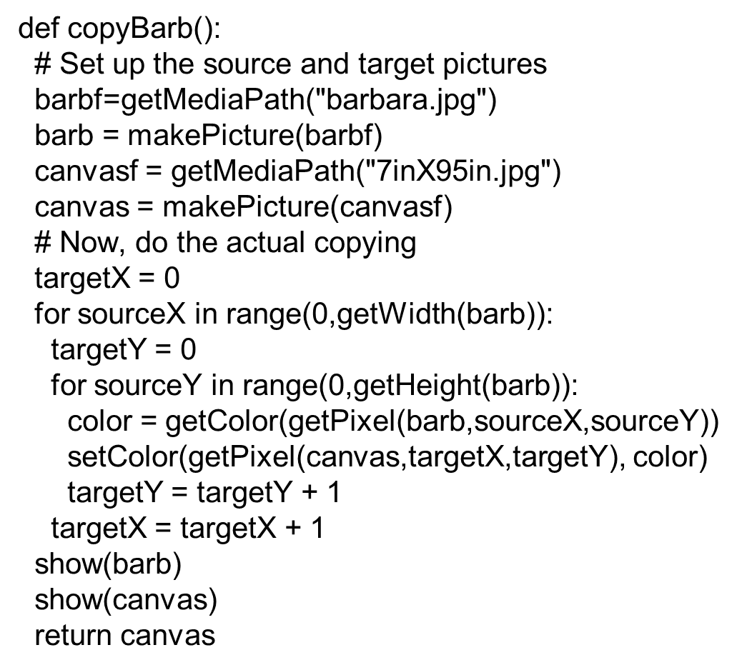
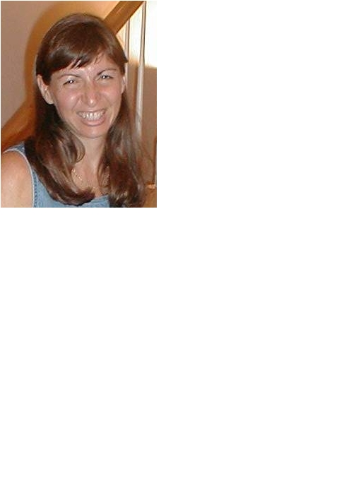
Copying Barb to a Canvas

Slide 41
Comments
Python ignores from “#” through the rest of the line
If you start a line with “#”, the whole line is ignored
Why do we want lines to be ignored?
To be able to leave notes to ourselves or someone else about how the program works

Slide 42
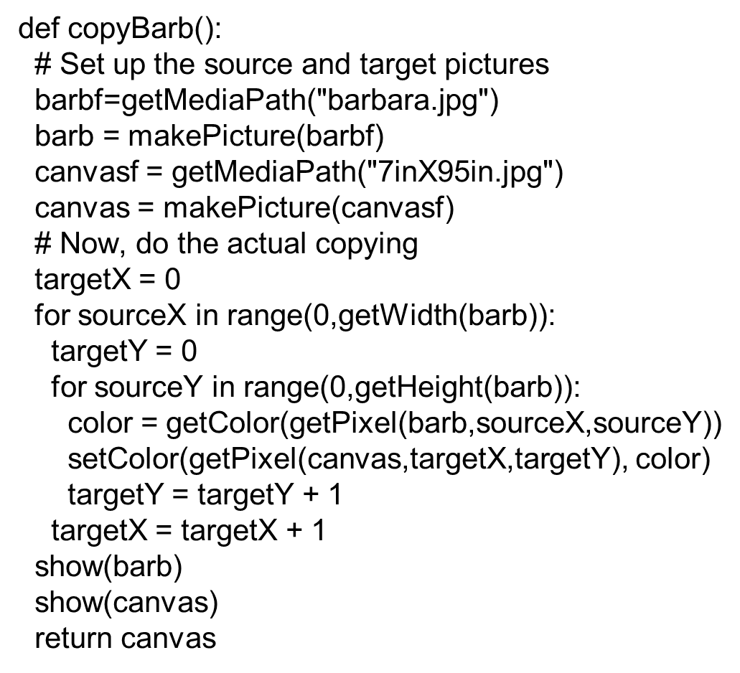
Walking through the Copying Function
First, get the source (barb) and target (canvas) files and pictures as names we can use later.

Slide 43
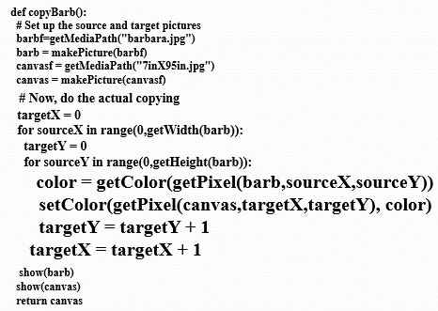
The Actual Copy
We get the color of the pixel at sourceX and sourceY
We set (copy) the color to the pixel in the target picture at targetX and targetY

Slide 44
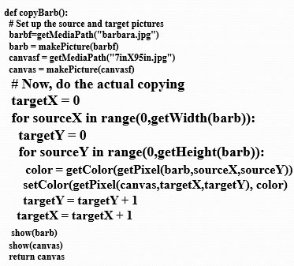
Setting up the Copy Loop
targetX gets set to 0 at the beginning
sourceX will range across the width of the source picture
INSIDE the loop, we set targetY to o
Inside because we want it to start at 0 each time we do a new X
sourceY will range from 0 to one less height of source

Slide 45
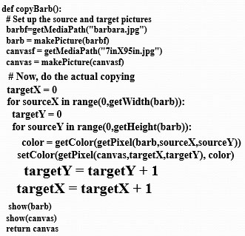
Ending the Loop
Just before we end the sourceY loop, we increment targetY
It’s now set up for the next time through the loop
It’s set correctly for the next value of sourceY
Just before we end the sourceX loop, we increment the targetX
Note carefully the indentation to figure out which goes with which loop

Slide 46
What’s This Naming Something as Itself?
targetX = targetX + 1
This isn’t really naming something as itself
targetX + 1 is evaluated
It will result in the number after targetX
targetX = then sets the value of targetX
The result is that targetX gets incremented by 1

Slide 47
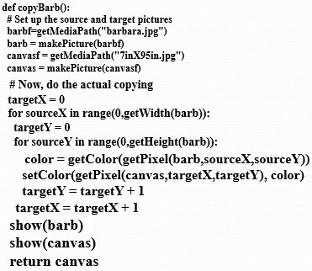
Ending the Copy Function
At the very end, we show the source and target
And return the modified target.

Slide 48
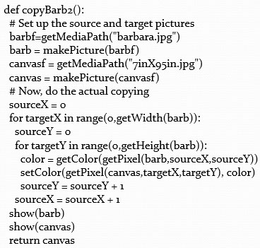
Works Either Way
As long as we increment sourceX and targetX together, and sourceY and targetY together, it doesn’t matter which is in the for loop and which is incremented via expression

Slide 49
Transformation = Small Changes in Copying
Making relatively small changes in this basic copying program can make a variety of transformations.
Change the targetX and targetY, and you copy wherever you want
Cropping: Change the sourceX and sourceY range, and you copy only part of the program.
Rotating: Swap targetX and targetY, and you end up copying sideways
Scaling: Change the increment on sourceX and sourceY, and you either grow or shrink the image.

Slide 50
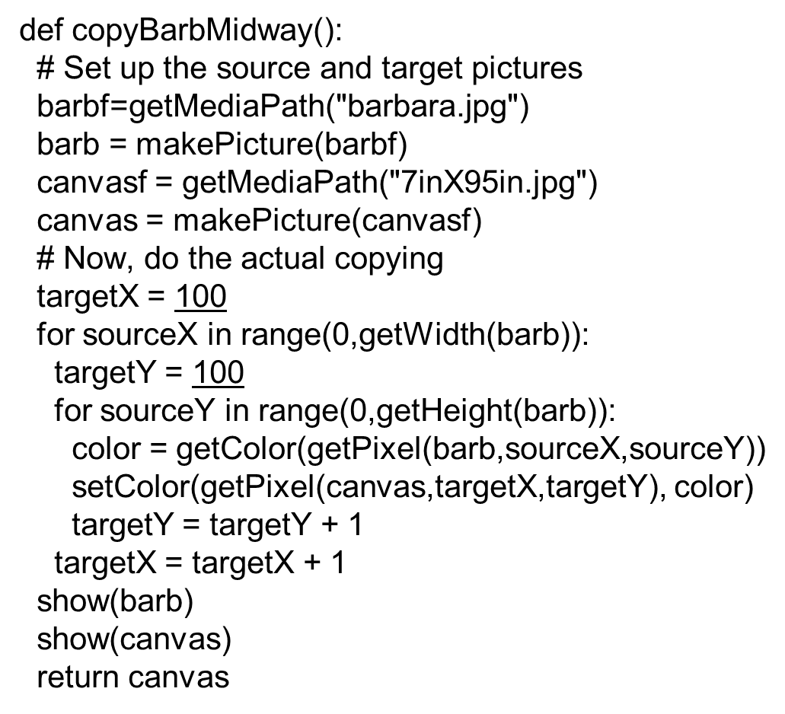
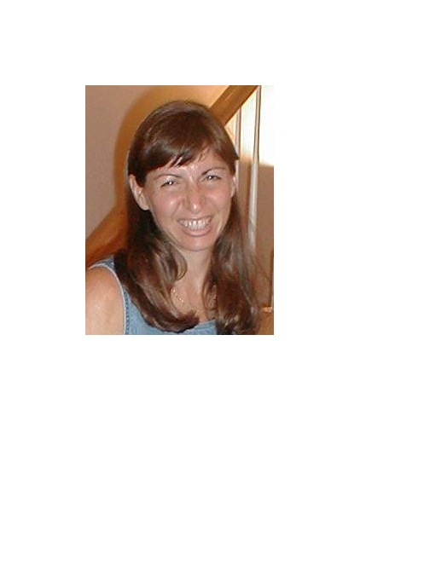
Copying into the Middle of the Canvas

Slide 51
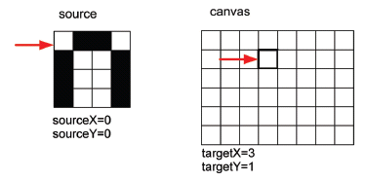
Copying: How it Works
Here’s the initial setup:

Slide 52
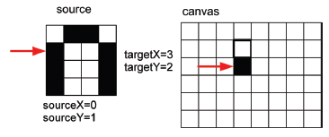
Copying: How it Works 2
After incrementing the sourceY and targetY once (whether in the for or via expression):

Slide 53
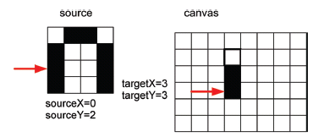
Copying: How it Works 3
After yet another increment of sourceY and targetY:
When we finish that column, we increment sourceX and targetX, and start on the next column.

Slide 54
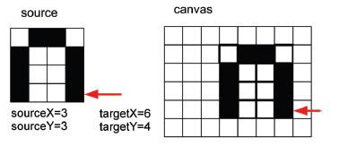
Copying: How it Looks at the End
Eventually, we copy every pixel

Slide 55
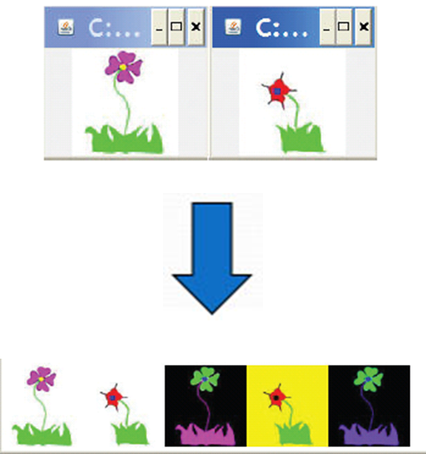
Making a Collage
Could we do something to the pictures we copy in?
Sure! Could either apply one of those functions before copying, or do something to the pixels during the copy.
Could we copy more than one picture!
Of course! Make a collage!

Slide 56
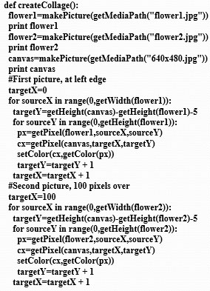
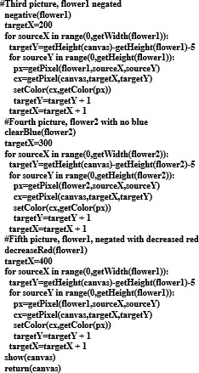
Creating a Collage

Slide 57
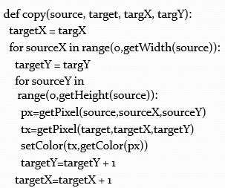
Can We Make That Easier?
The collage code is long, yet simple.
It’s the same thing over-and-over.
We can generalize that copying loop, and with parameters, use it in many places.

Slide 58
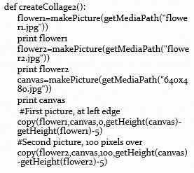
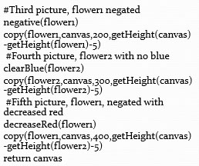
Exact Same Collage!

Slide 59
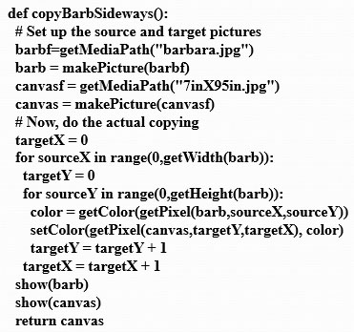

Rotating the Copy

Slide 60

Rotating: How it Works
We increment the same, but we use targetX for the Y coordinate and targetY for the X coordinate

Slide 61

Rotate: How it Ends
Same amount of increment, even same values in the variables, but a different result.

Slide 62

Doing a Real Rotation

Slide 63


Cropping: Just the Face

Slide 64

Cropping, Another Way

Slide 65
Scaling
Scaling a picture (smaller or larger) has to do with sampling the source picture differently
When we just copy, we sample every pixel
If we want a smaller copy, we skip some pixels
We sample fewer pixels
If we want a larger copy, we duplicate some pixels
We over-sample some pixels

Slide 66


Scaling the Picture Down

Slide 67

Scaling up: Growing the Picture
To grow a picture, we simply duplicate some pixels
We do this by incrementing by 0.5, but only use the integer part.

Slide 68


Scaling the Picture up

Slide 69

Scaling up: How it Works
Same basic setup as copying and rotating:

Slide 70

Scaling up: How it Works 2
But as we increment by only 0.5, and we use the int() function, we end up taking every pixel twice.
Here, the blank pixel at (0,0) in the source gets copied twice onto the canvas.

Slide 71

Scaling up: How it Works 3
Black pixels gets copied once…

Slide 72

Scaling up: How it Works 4
And twice…

Slide 73

Scaling up: How it Ends up
We end up in the same place in the source, but twice as much in the target.
Notice the degradation:
Gaps that weren’t there previously
Curves would get “choppy”: Pixelated

Slide 74
What to Do?
How do we clear up the degradation of scaling up?
Variety of techniques, but mostly following the same basic idea:
Use the pixels around to figure out what color a new pixel should be, then somehow (e.g., by averaging) compute the right color.
Different techniques look at different pixels and compute different averages in different ways.

Slide 75

A Blurring Recipe
We’ll see pass and else later, but you can probably get a sense here of what’s going on.

Slide 76


Blurring out the Pixelation

Slide 77
Things to Try:
Can you come up with general copy, rotate, copy, and scale functions?
Take input pictures and parameters
Return the canvas the correct transformation applied
Also think about generalizing the transformations:
Scaling up and down by non-integer amounts
Rotating by something other than 90 degree increments

Slide 78

Copyright

